Slide 1
Irony Detection in English Tweets
By
Amrita Sundari V

Slide 2
What is Irony and why is it important to detect Irony?
Irony is a common phenomenon in human communication and is identified generally when the actual meaning differs from the intended meaning.
Oh Great! Another Rainy Day… How wonderful!!
Monday mornings are my favourite!! Yay!!
Regular Sentiment analysis which categorises any opinions expressed in a statement into positive, negative and neutral will fail when there is an IRONY present.
Therefore it is important to detect irony in the statement in order to improve such sentiment analysis systems.

Slide 3
Dataset
The dataset is provided by a competition called semeval-2018
The training dataset consist of twitter data 3834 tweets labeled 0 or 1 to indicate the presence of irony.

Slide 4
Preprocessing of the twitter data
Stopwords: English stop words are the commonly used words such as “the”, “as”, “it”, etc. Since it has no significant role in case of irony , they have been removed from the original tweets
URLs and @references : Just like stop words, URLs and references are also of not much of importance and doesn’t provide any cues for Irony.
Hashtag data: In contrast to the previous categories hashtag data are of much use. Some users deliver the polarity contrast in the hashtags. Eg. “Monday mornings are my fave :) #not”. So the hashtags (#) are removed but the words accompanying are retained.
TOKENISATION:
Each tweet is converted to a list of tokens(words) after all the preprocessing is done.

Slide 5
Feature Extraction
I have extracted the following 6 sets of features from each tweet .
Rare and Common words (Frequency of the rarest word, difference in frequency of the rarest word and the most common word….)
Structure (punctuations,length,no.of words,nouns,verbs,adjective,adverbs)
Internet laughs and Emoticons (lol,lmao,rofl… and :) :P ;) etc)
Sentiments (total polarity of the tweet,number of positive,negative words,difference)
Synonyms and the ambiguity factors (number of synonyms for each word,.)
Apart from these special set of features, I have also included Bag-of-Words features incorporating token unigrams.

Slide 6
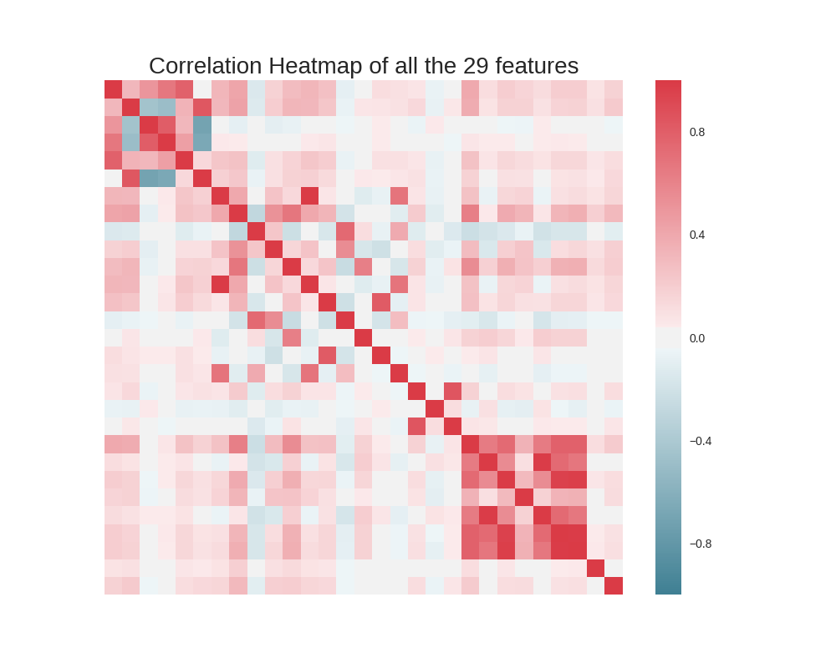
Feature analysis
The correlation matrix is as shown in the figure, It can be seen that most of the features have very less correlations with the others.

Slide 7
Experiment
Classifiers | Accuracy | Recall | Precision | F-score
Decision Tree | 0.564 | 0.558 | 0.5635 | 0.5612
Random Forest | 0.598 | 0.571 | 0.602 | 0.5866
Gaussian NB | 0.571 | 0.732 | 0.553 | 0.629
Linear SVM | 0.6392 | 0.6185 | 0.6437 | 0.6309

Slide 8
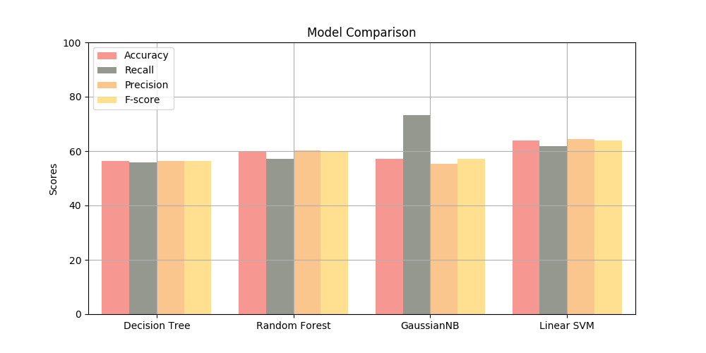
Experiment(contd..)

Slide 9
Conclusion
The Linear SVM classifier performs the best as we can see from the model comparison plots.
The Features are mostly uncorrelated and to further improve the system performance, I am trying to remove the redundant features(highly correlated features) from the feature set.
Things Learnt:
I have a better understanding of the different classifier algorithms mentioned above.
Also I have also learnt a lot about Natural Language processing and related tools such as RegEx, POS tagging, Sentiment Analysis , different python packages NLTK, WordNet, etc.

